Slide 1
Group 101: Software Engineering
Sprint 2

Slide 2
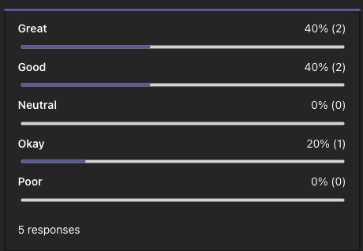
Teams Overall Thoughts

Slide 3
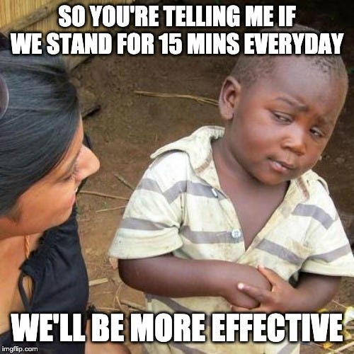
How Did the Sprint Go?
What Went Well
Communication (along with daily text standups)
Stayed on track within the sprint (closed issues when done, created subtasks)
Everyone's expectations aligned when it came to the Excel UI and parsing individual prerequisites
Areas of Improvement
Spotting of future issues earlier
Team programming
Trying to cover all edge cases initially

Slide 4
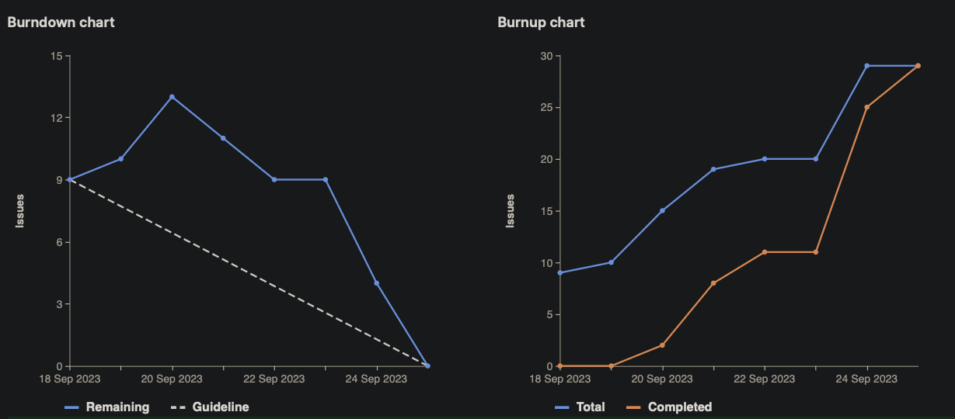
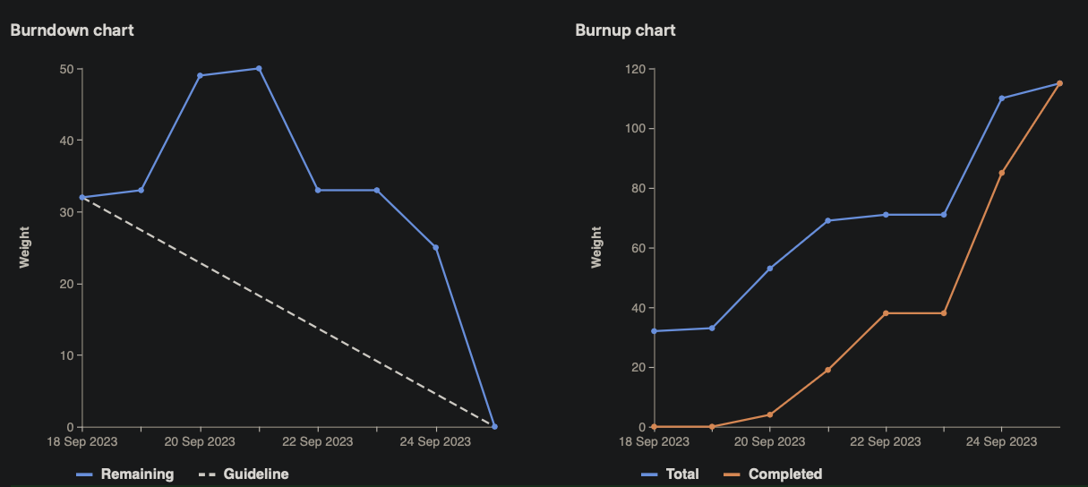
Burndown Charts

Slide 5
Quick note about weights

Slide 6

Maneesh
20
Lead sprint planning, team meetings, follow ups, etc.
Reviewed MR's, resolved merge conflicts, kept the repo organized
Highlight of sprint:
Being a team lead for the first time (shocking)

Slide 7
Sara
24
Designed and implemented the new parsing logic for prerequisites in order for them to be more readable and consistent for the VBA portion
Highlight of sprint:
Understanding and working with regex more

Slide 8
Simardeep
19
Designed and implemented a way to parse out restrictions from the text file as this was needed to check for eligibility for course registration
Highlight of sprint:
The parsing of restrictions and the combining of codes for parsing prerequisites and restrictions

Slide 9
Emily
20
Designed and implemented the backend portion of VBA which handles the logic of displaying eligible courses for the student
Highlight of sprint:
Working with a new technology - VBA

Slide 10
Fee Kim
20
Designed and implemented the Excel UI so that the student can input their courses and click a button to get eligibility information
Highlight of sprint:
Learnt more VBA and how there are restrictions between Windows and MacOS

Slide 11
DEMO

